Slide 1

Hello Green! Project management and reporting framework
Tim McKeaveney
Daniel Gregg

Slide 2
What is Hello Green?
Hello Green is a prototype reporting and project management application.
Hello Green allows managers of report-based projects (i.e. written reports) to manage the contributions of team members and to arrange those contributions around a reporting structure that simultaneously defines their contributions and provides for a reporting framework that is both comprehensive (full report) and compartmentalised (project briefs).
The current presentation of Hello Green focuses on the latter: the creation, editing, and viewing of project briefs: the ‘parts’ that make up the ‘whole’.

Slide 3

The concept behind Hello Green
Hello Green is an initial prototype of an online reporting framework. The aim is to provide basic functionality for the submission of ‘project briefs’, editing of these, and viewing of the users that create them.
Whilst similar to a blog-post website, the Hello Green application constraints users to be invited only, and to provide an elementary capability for integration into a larger project reporting framework in the future.
Hello Green was inspired by difficulties in integrating reporting needs within large teams, and to allow these reports to be well-structured whilst providing for meeting multiple objectives with single activities (i.e. similar to the DRY principle in coding)
Our User story is as follows:
As a viewer
I want to view basic descriptions of project briefs
SO that I select briefs to read more about
I want to view the authors of project briefs
SO that I can direct correspondence toward them
As an author
I want to be able to login
SO that I can view my dashboard
I want to view my current posts
SO that I can choose which of those to edit
I want to view my bio
SO that I can update details

Slide 4
The process involved in creating Hello Green
Technologies Used:
Javascript, Node, Express server with an MySQL database and Handlebars templating engine.
Challenges:
Reducing scope to an MVP that was still ‘interesting’ to us both
Git – issues with lost code. Think from slow wifi maybe?
Chunking tasks to enable good workflow
Tasks Breakdown:
TM,DG: planning, reducing TM: DB models and seeds
DG: Handlebars views, CSS
TM, DG: Routes
(TM mainly on initial DB routes and DG on setting model requirements and put/post routes)
Successes:
Reducing scope whilst maintaining ‘hooks’ for the future
Git – we did have a pretty good workflow and managed to limit Githaps
Cross-over – working together on issues and learning from each other

Slide 5
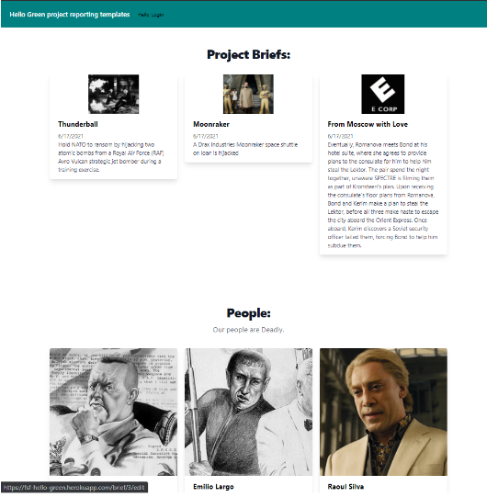

Slide 6


Slide 7
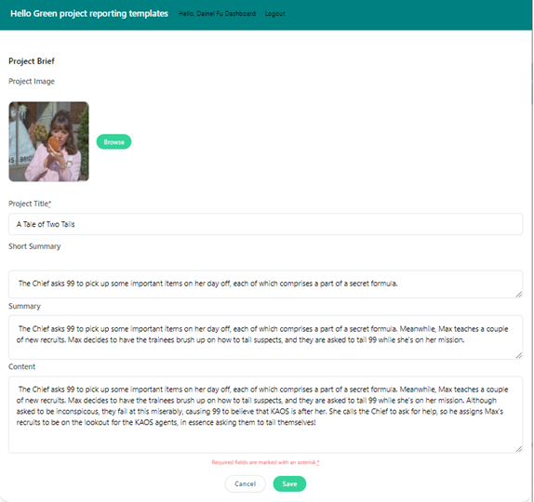

Slide 8
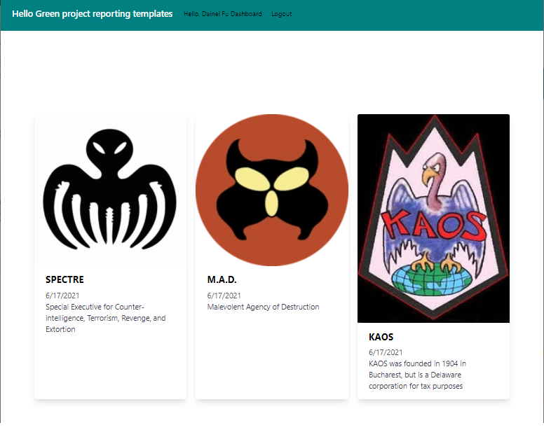

Slide 9
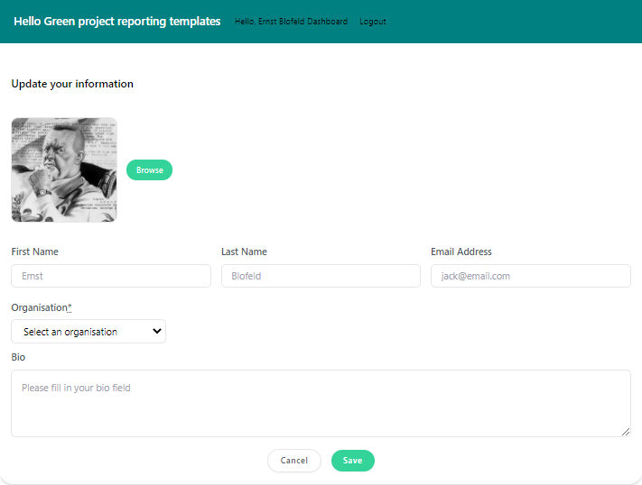

Slide 10


Links
Deployment link GitHub link

